Slide 1



Political Juggernauts: A Quantitative Analysis of Candidates in the 2019 Lok Sabha Elections
SUBMITTED BY
DILLIRANI G 35621U25004
SANDHIYA P 35621U25026
DINESH E 35621U25005
JAISANKAR B 35621U25013
Under the Guidance of
Mr.K.SANGEETHA THULASI RAMAN M.Sc., M.Phil.,B.Ed.,SET
PG-DEPARMENT OF MATHEMATCS
GOVERNMENT ARTS AND SCIENCE COLLEGE (Attupakam) , ARAKKONAM-631051, RANIPET DISTRCT,
TAMIL NADU.

Slide 2
INTRODUCTION :
The 17th Lok Sabha or lower house of India’s bicameral parliament was elected based on the results of the world’s biggest election conducted in the summer of 2019. This was the largest democratic and the most expensive election in the world. Narendra Modi’s Bharatiya Janata Party had a consecutive win with a majority of 303 out of 543 parliamentary seats. The voting trend followed the pattern of the previous election in 2014, ensuring a second prime-ministerial term for Modi. Interestingly, this election witnessed an increased participation from women and young Indians. In addition, there were many young, educated candidates contesting as compared to previous years resulting in the highest number of women parliamentarians. Along with Modi, around 230 members won a second term, totaling ten years as the ruling party.

Slide 3
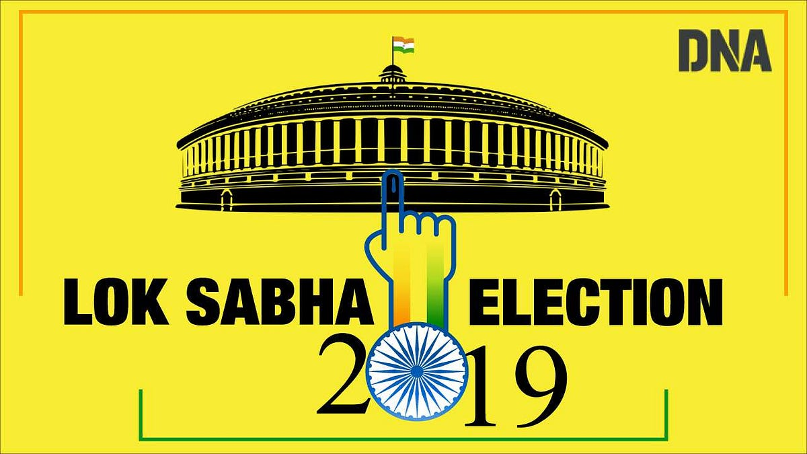

Slide 4
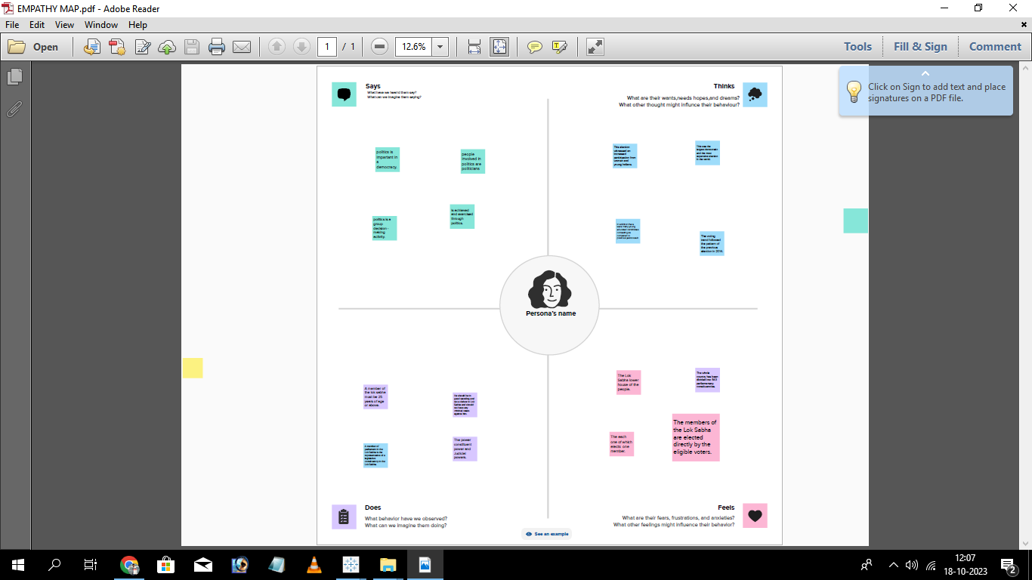
EMPATHY MAP

Slide 5
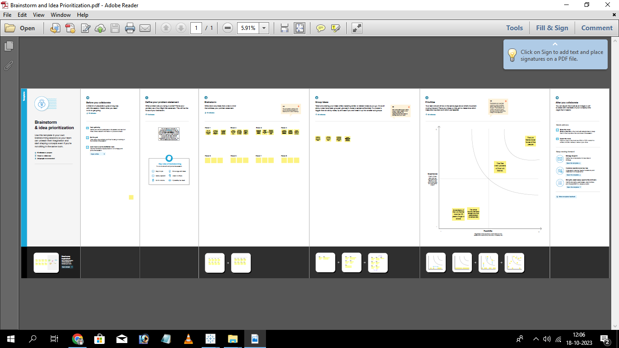
BRAINSTORM

Slide 6
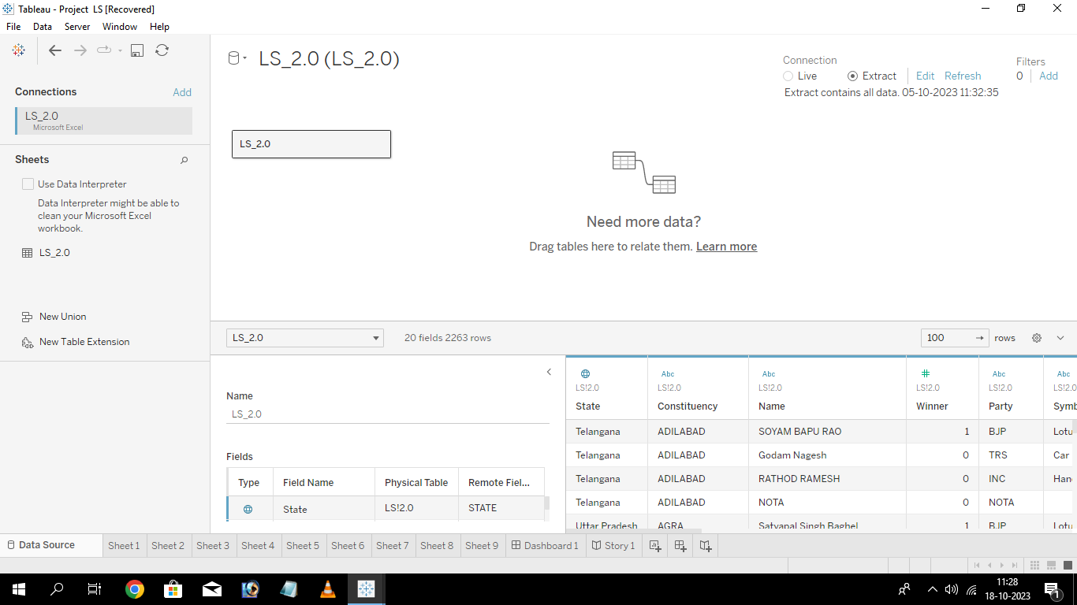
DATASET

Slide 7
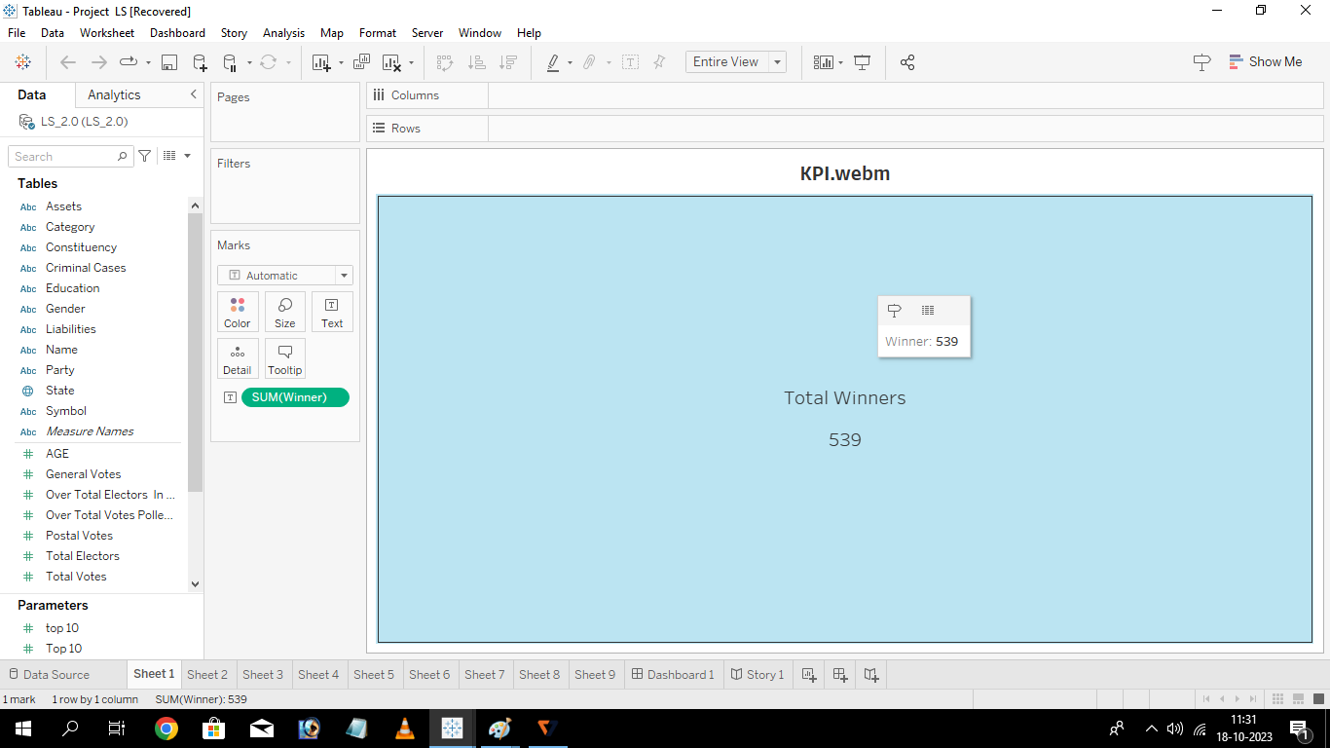
KPI WEBM

Slide 8
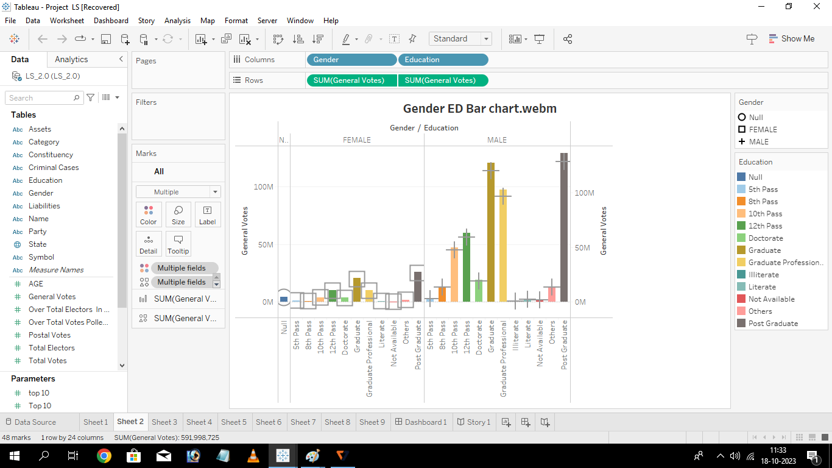
GENDER ED BAR CHART WEBM

Slide 9
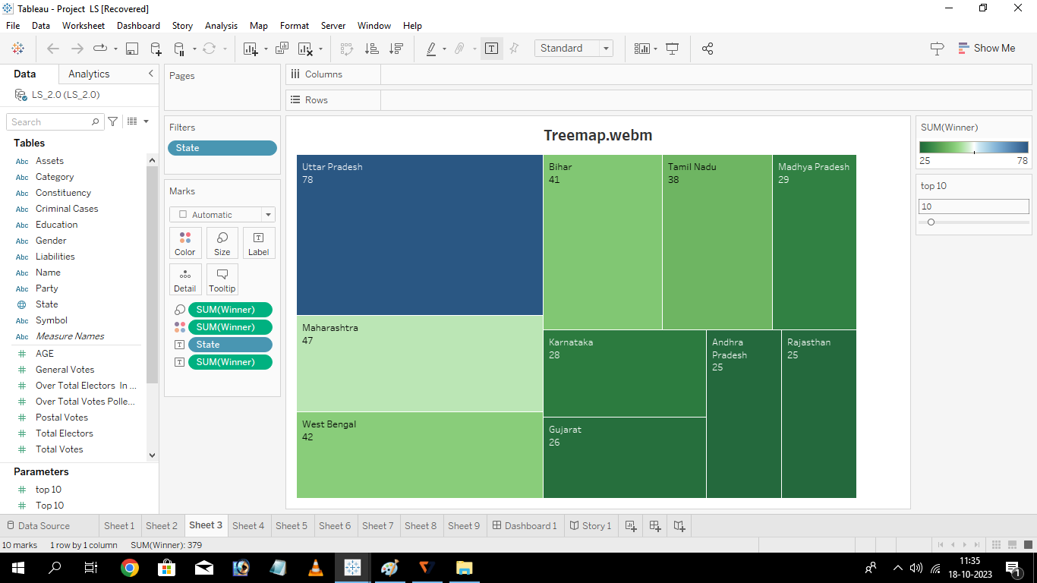
TREEMAP WEBM

Slide 10
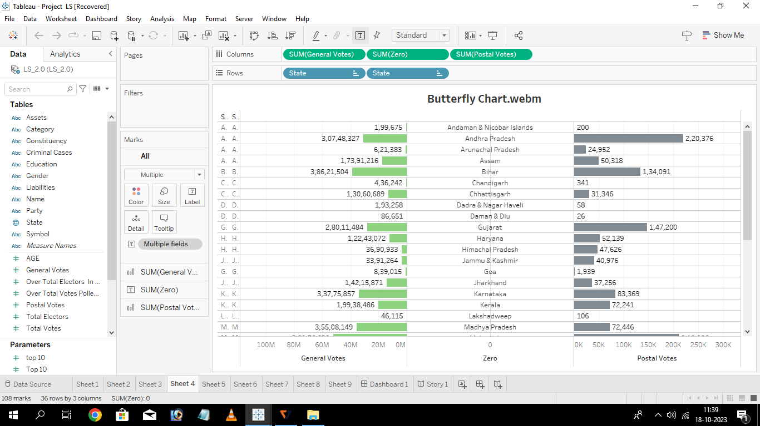
BUTTERFLY CHART WEBM

Slide 11
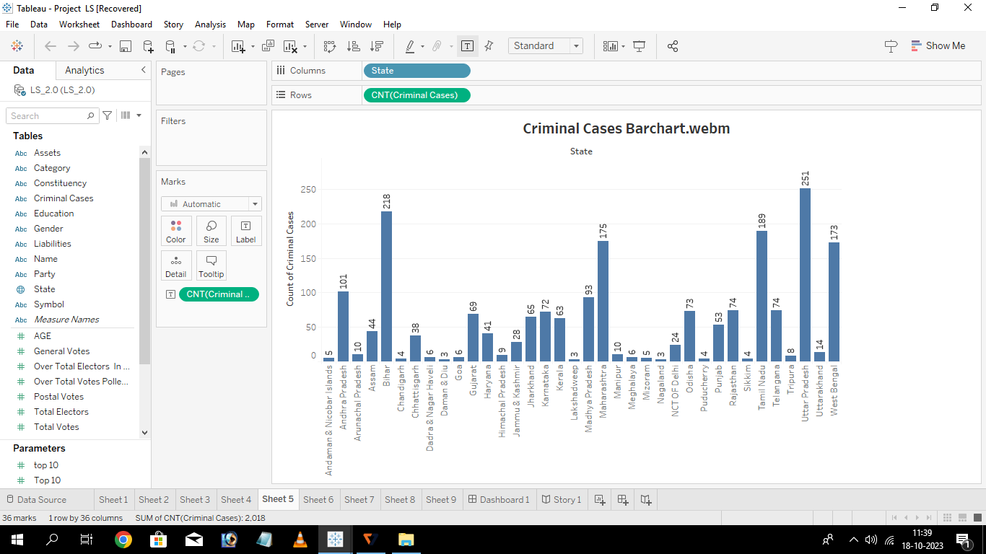
CRIMINAL CASES BARCHART WEBM

Slide 12
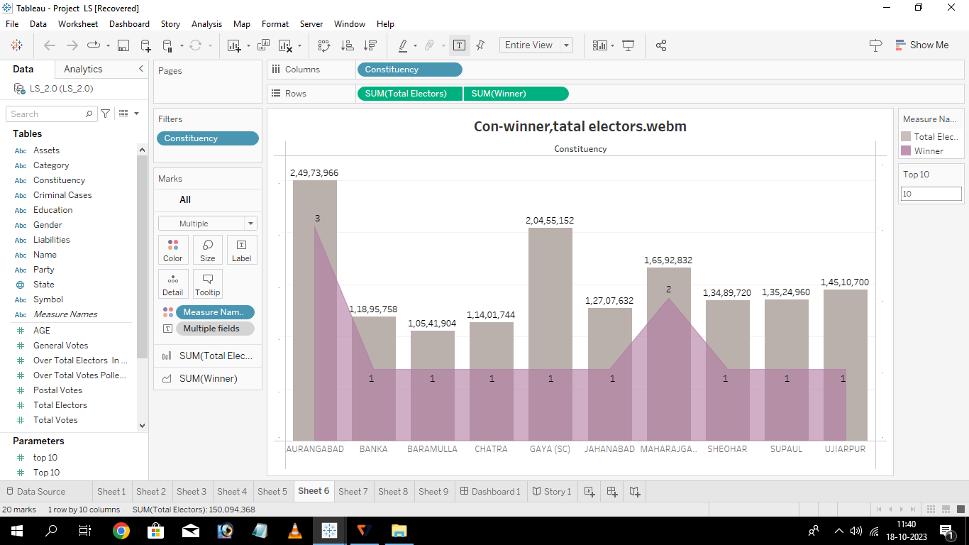
CON WINNER TOTAL ELECTORS WEBM

Slide 13
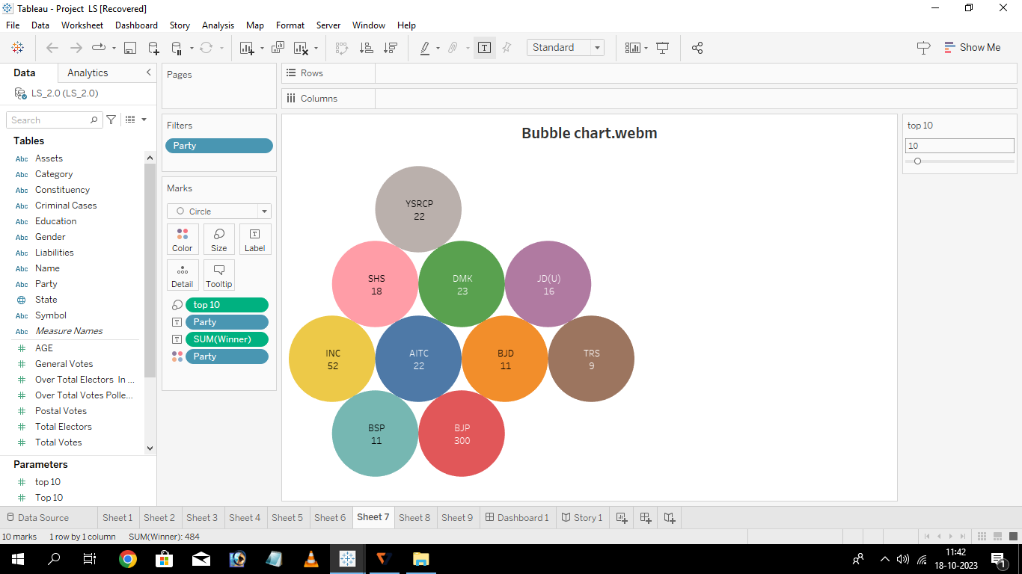
BUBBLE CHART WEBM

Slide 14
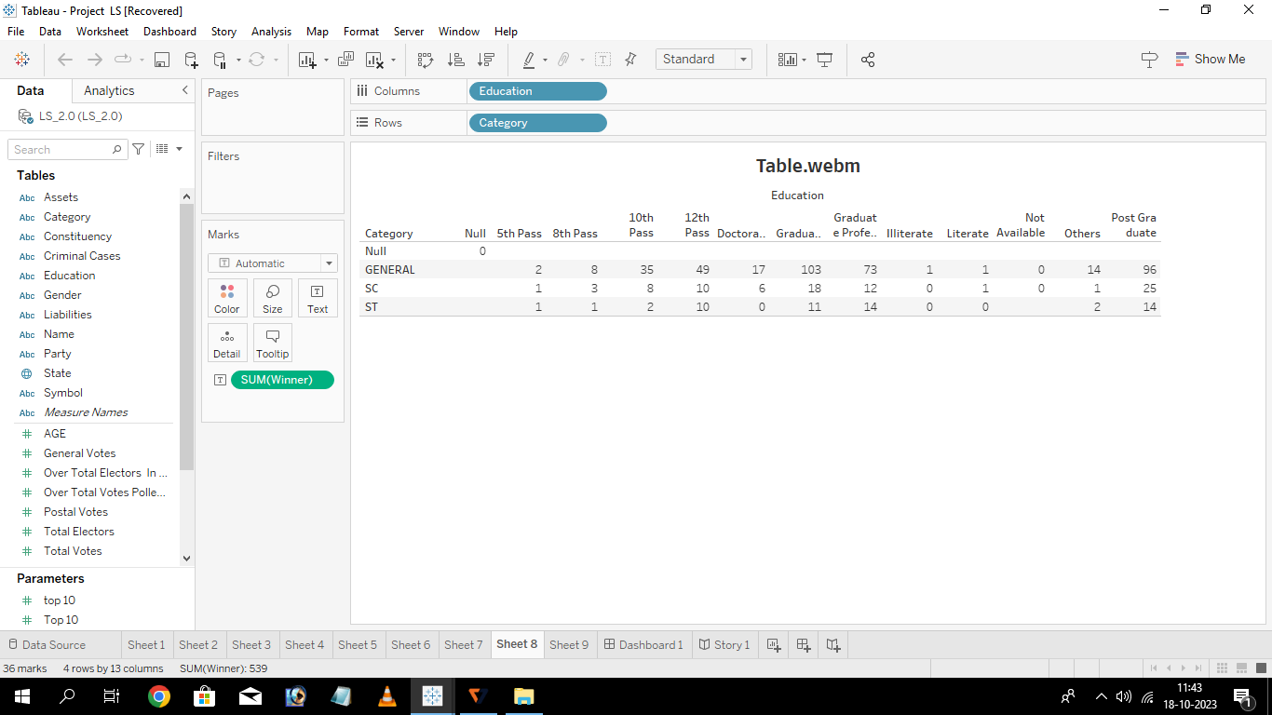
TABLE WEBM

Slide 15
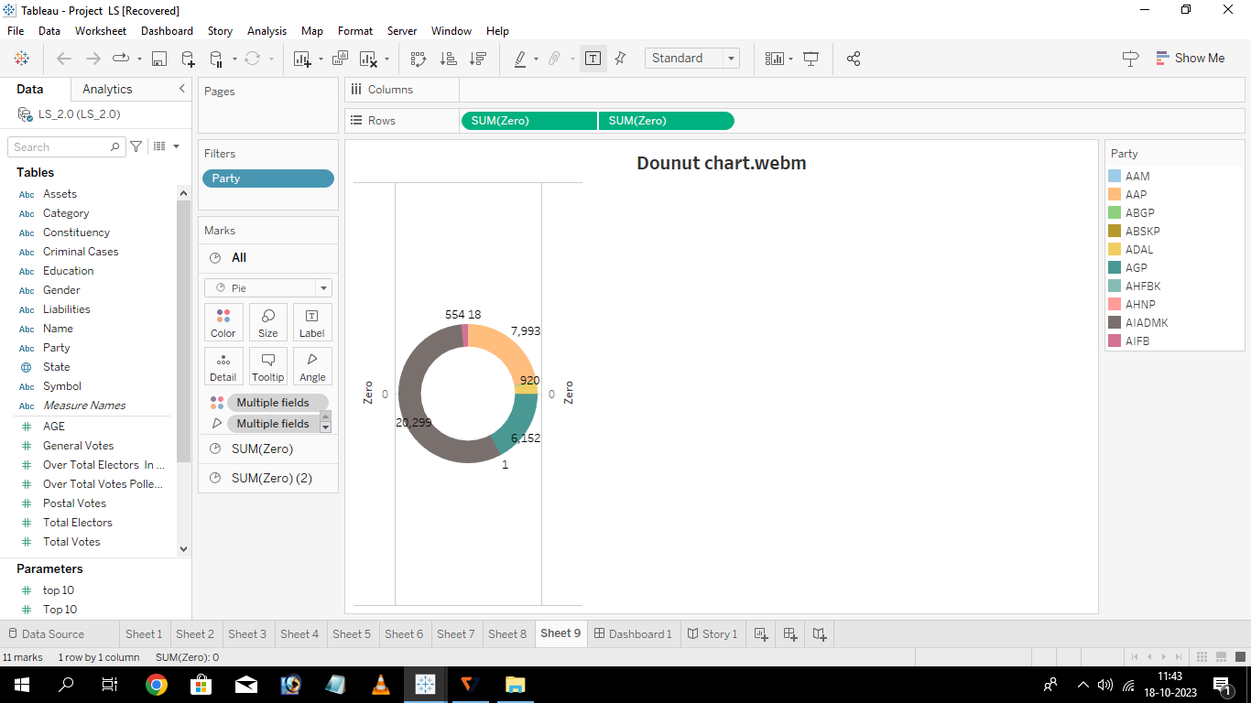
DOUNT CHART WEBM

Slide 16
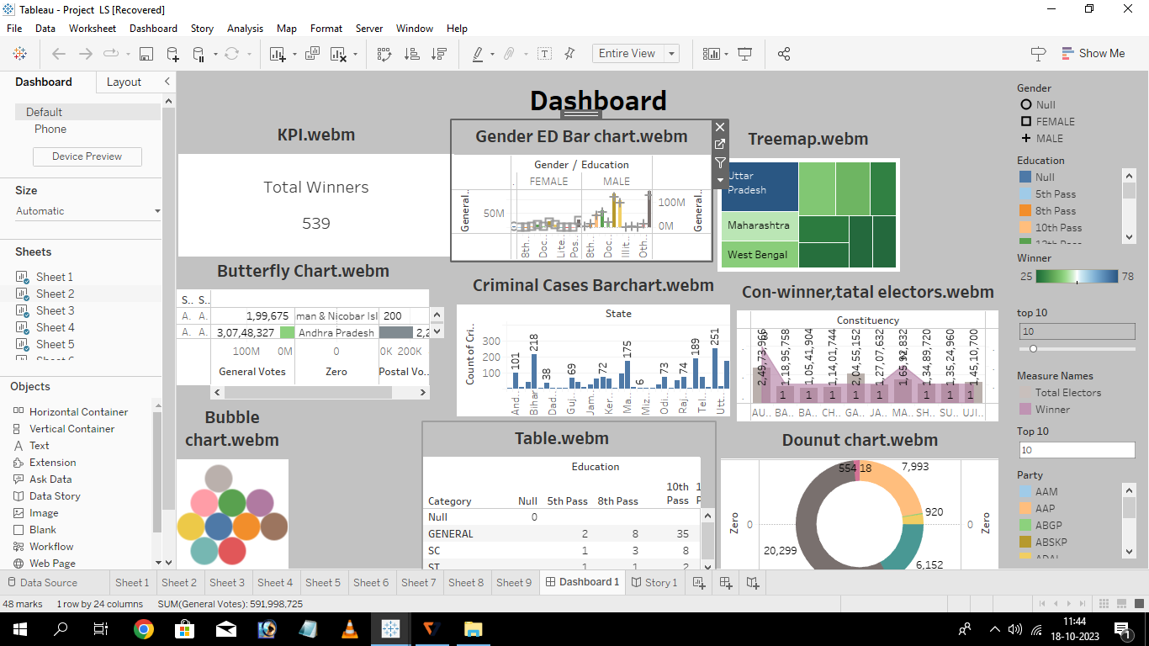
DASHBOURD

Slide 17
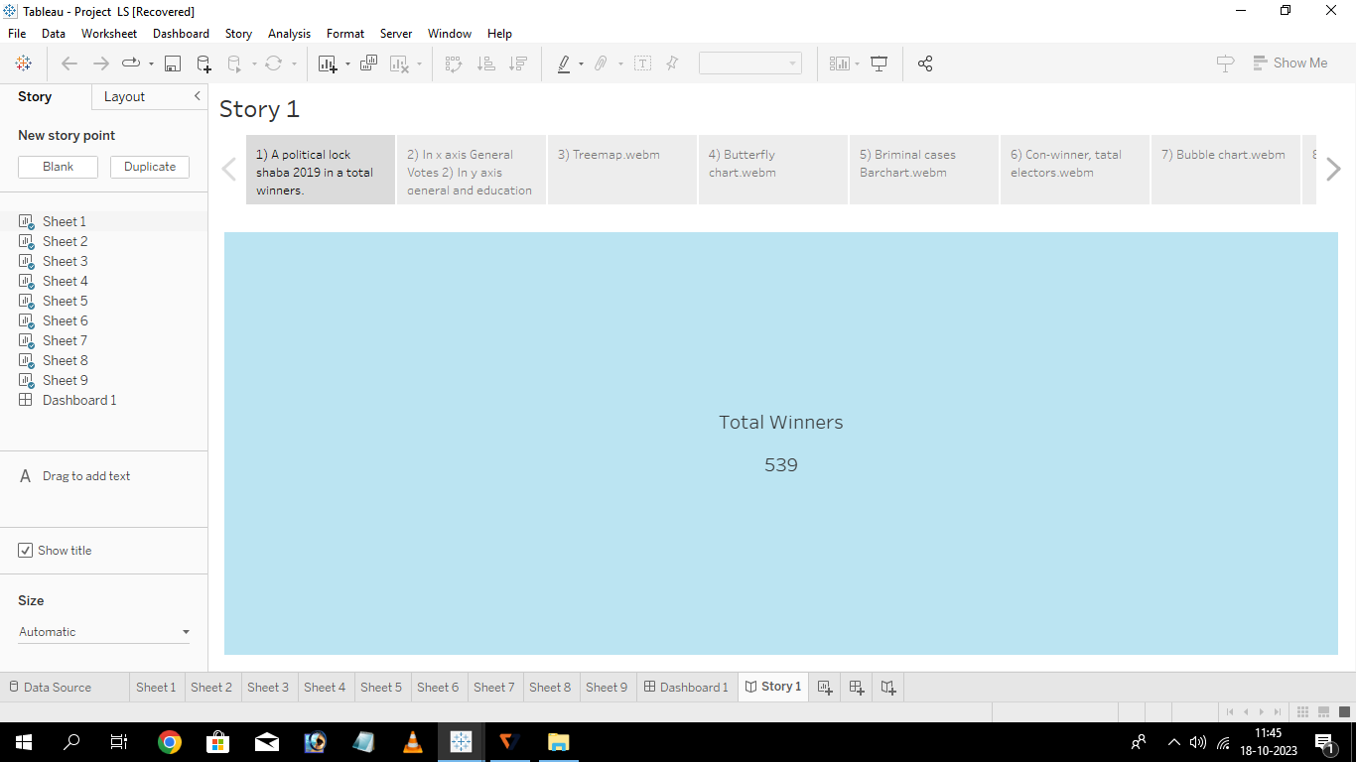
STORY

Slide 18
CONCLUSION
From this analysis, we have found that Indians are very much aware of the voting system and political parties. The vote percentage is very good in Kerala, West Bengal, Manipur, Maharashtra, etc.
The BJP candidates have participated more than the other parties in Lok Sabha 2019.
The number of female candidates is very less than the number of male candidates.
Unfortunately, we found that the candidates of Kerala have maximum criminal cases history, and West- Bengal, Uttar Pradesh, and Telangana are not far behind. The maximum no of criminal cases done by a single person is 240 and he is from Kerala.
We have noticed that the history of the criminal case of candidates is maximum at the age of 49,37, and 51.

